Slide 1
INTRODUCTION TO
EMBEDDED SYSTEMS

Slide 2
What is an Embedded System?
An embedded system is one that has computer hardware with software embedded in it as one of its components. Or
We can define an embedded system as “A microprocessor based system that does not look like a computer”.
Or
We can say that it is “A combination of computer hardware and software, and perhaps additional mechanical or other parts, designed to perform a dedicated function. In some cases, embedded systems are part of a larger system or product, as is the case of an antilock braking system in a car ”.
An embedded system is a special-purpose computer system designed to perform certain dedicated functions. It is usually embedded as part of a complete device including hardware and mechanical parts.

Slide 3
Significance
Due to their compact size, low cost and simple design aspects made embedded systems very popular and encroached into human lives and have become indispensable. They are found everywhere from kitchen ware to space craft. To emphasize this idea here are some illustrations.

Slide 4
Embedded Systems Everywhere
Embedded systems span all aspects of modern life and there are many examples of their use.
Biomedical Instrumentation – ECG Recorder, Blood cell recorder, patient monitor system
Communication systems – pagers, cellular phones, cable TV terminals, fax and transreceivers, video games and so on.
Peripheral controllers of a computer – Keyboard controller, DRAM controller, DMA controller, Printer controller, LAN controller, disk drive controller.
Industrial Instrumentation – Process controller, DC motor controller, robotic systems, CNC machine controller, close loop engine controller, industrial moisture recorder cum controller.
Scientific Instruments – DMM, digital storage system, CRT display, Spectrum Analyzer.

Slide 5
Were the Embedded Systems Existing Earlier ?
Yes, We have been enjoying the grace of embedded system quite a long time. But they were not so popular because in those days most of the embedded systems were designed around a microprocessor unlike today’s systems which were built around a microcontroller.
As we know a microprocessor by itself do not possess any memory, ports etc. So everything must be connected externally by using peripherals like 8255, 8257, 8259 etc.
So the embedded system designed using microprocessor was not only complicated in design but also large in size. At the same time the speed of microprocessor is also a limitation for high end applications.

Slide 6
Why a Microcontroller ?
A microcontroller is a single silicon chip with memory and all Input / Output peripherals on it. Hence a microcontroller is also popularly known as a single chip computer.
Normally, a single microcontroller has the following features :
    Arithmetic and Logic Unit
    Memory for Storing Program
    EEPROM for Nonvolatile Data Storage
    RAM for storing variables and special function registers
    Input / Output ports
    Timers and Counters
    Analog to Digital converter
    Circuits for reset, Power up, Serial programming, Debugging
    Instruction decoder, Timing and Control unit
    Serial Communication port
So, its no wonder to say that the Microcontroller is the most wanted device for designing an efficient Embedded System.

Slide 7
What is inside an
Embedded System ?
Every embedded system consists of custom-built hardware around a Central Processing Unit (CPU). This hardware also contains memory chips onto which the software is loaded. The software residing on the memory chip is also called the ‘Firmware’.
The operating system runs above the hardware, and the application software runs above the operating system. The same architecture is applicable to any computer including a desktop computer. However, there are significant differences. It is not compulsory to have an operating system in every embedded system.
For small appliances such as remote control units, air-conditioners, toys etc., there is no need for an operating system and we can write only the software specific to that application. For applications involving complex processing, it is advisable to have an operating system.
In such a case, you need to integrate the application software with the operating system and then transfer the entire software on to the memory chip. Once the software is transferred to the memory chip, the software will continue to run for a long time and you don’t need to reload new software .

Slide 8
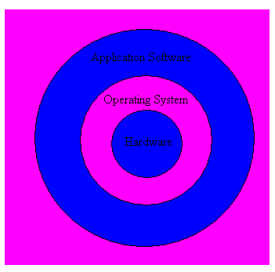
Layered Architecture of an Embedded System

Slide 9
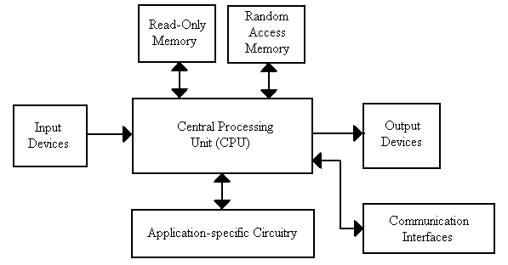
Hardware Architecture of an Embedded System

Slide 10
Features of an
Embedded system
Embedded systems do a very specific task, they cannot be programmed to do different
things:
Embedded systems have very limited resources, particularly the memory. Generally, they do not have secondary storage devices such as the CDROM or the floppy disk.
Embedded systems have to work against some deadlines. A specific job has to be completed within a specific time. In some embedded systems, called Real Time Systems, the deadlines are stringent. Missing a dead line may cause a catastrophe – loss of life or damage to property.
Embedded systems are constrained for power, As many embedded systems operate through a battery, the power consumption has to be very low.
Embedded systems need to be highly reliable. Once in a while, pressing ALT-CTRL-DEL is OK on your desktop, but you cannot afford to reset your embedded system.
Some embedded systems have to operate in extreme environmental conditions such as very high temperatures and humidity.
Embedded systems that address the consumer market (for example electronic toys) are very cost-effective. Even a reduction of Rs.10 is lot of cost saving, because thousands or millions systems may be sold.
Unlike desktop computers in which the hardware platform is dominated by Intel and the operating system is dominated by Microsoft, there is a wide variety of processors and operating systems for the embedded systems. So, choosing the right platform is the most complex task .

Slide 11
Classification of
Embedded Systems
Based on functionality and performance requirements, embedded systems classified as :
  Stand alone Embedded Systems
  Real time Embedded Systems
  Networked Information Appliances/Systems
  Mobile Devices

Slide 12
Stand alone Embedded Systems
As the name implies, stand-alone systems work in stand alone mode. They take inputs, process them and produce the desired output.
The input can be electrical signals from transducers or commands from a human being such as the pressing of a button.
The output can be electrical signals to drive another system, an LED display or LCD display for displaying of information to the users.
Embedded systems used in process control, automobiles, consumer electronic items etc. fall into this category.

Slide 13
Real time Embedded Systems
Embedded systems in which some specific work has to be done in a specific time period are called real-time systems.
For example, consider a system that has to open a valve within 30 milliseconds when the humidity crosses a particular threshold. If the valve is not opened within 30 milliseconds, a catastrophe may occur. Such systems with strict deadlines are called hard real time systems.
In some embedded systems, deadlines are imposed, but not adhering to them once in a while may not lead to a catastrophe. For example, consider a DVD player. Suppose, you give a command to the DVD player from a remote control, and there is a delay of a few milliseconds in executing that command. But, this delay won’t lead to a serious implication. Such systems are called soft real time systems .

Slide 14
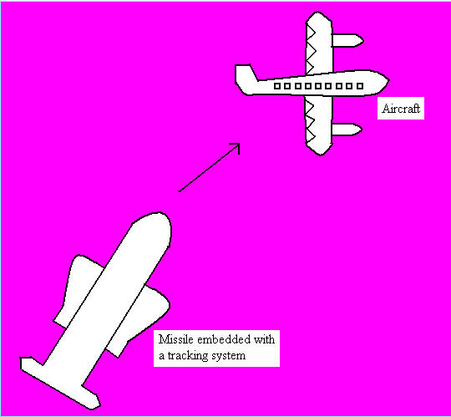
Hard Real Time Embedded System

Slide 15
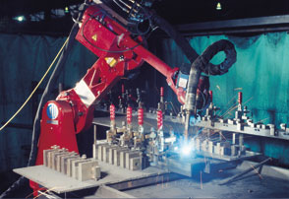
Must be able to respond predictably
and in a known amount of time
Environment cannot wait for
microcontroller to respond.

Slide 16
Networked Information Appliances
Embedded systems that are provided with network interfaces and accessed by networks such as Local Area Network or the Internet are called networked information appliances.
Such embedded systems are connected to a network, typically a network running TCP/IP (Transmission Control Protocol/Internet Protocol) protocol suite, such as the Internet or a company’s Intranet.
These systems have emerged in recent years.
These systems run the protocol TCP/IP stack and get connected through Ethernet to network and communicate with other nodes in the network.

Slide 17
Cont…
Here are some examples of such systems
A networked process control system consists of a number of embedded systems connected as a local area network. Each embedded system can send real-time data to a central location from where the entire process control system can be monitored. The monitoring can be done using a web browser such as the Internet Explorer
A web camera can be connected to the Internet. The web camera can send pictures in real-time to any computer connected to the Internet. In such a case, the web camera has to run the HTTP server software in addition to the TCP/IP protocol stack.
The door lock of your home can be a small embedded system with TCP/IP and HTTP server software running on it. When your children stand in front of the door lock after they return from school, the web camera in the door-lock will send an alert to your desktop over the Internet and then you can open the door lock through a click of the mouse.

Slide 18
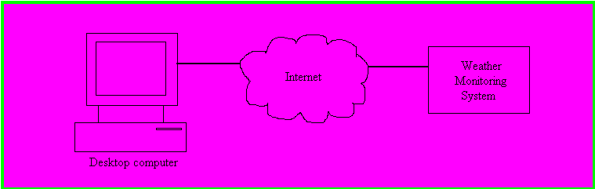
Cont…
A weather monitoring system connected to the Internet. TCP/IP protocol suite and HTTP web server software will be running on this system. Any computer connected to the Internet can access this system to obtain real-time weather information.
The networked information appliances need to run the complete TCP/IP protocol stack including the application layer protocols. If the appliance has to provide information over the Internet, HTTP web server software also needs to run on the system.

Slide 19
Mobile Devices
Mobile devices such as mobile phones, Personal Digital Assistants (PDAs), smart phones etc. are a special category of embedded systems. Though the PDAs do many general purpose tasks, they need to be designed just like the ‘conventional’ embedded systems.
The limitations of the mobile devices – memory constraints, small size, lack of good user interfaces such as full fledged keyboard and display etc. are same as those found in the embedded systems discussed above. Hence, mobile devices are considered as embedded systems.
However, the PDAs are now capable of supporting general purpose application software such as word processors, games, etc.

Slide 20
Languages for Programming Embedded Systems
Assembly language was the pioneer for programming embedded systems till recently. Nowadays there are many more languages to program these systems. Some of the languages are C, C++, Ada, Forth, and Java together with its new enhancement J2ME.
The majority of software for embedded systems is still done in C language.
C++ is also increasing its presence in embedded systems. As C++ is based on C language, thus providing programmer the object oriented methodologies to reap the benefits of such an approach.
C is very close to assembly programming and it allows very easy access to underlying hardware. A huge number of high quality compilers and debugging tools are available for the C language.

Slide 21
Cont…
Though C++ is theoretically more efficient than C, but some of its compilers have bugs due to the huge size of the language. These compilers may cause a buggy execution.
C language can definitely claim to have more mature compilers then C++. Now in order to avail the extra benefits of C++ and plus to avoid buggy execution, experts are doing efforts to identify a subset of C++ that can be used in embedded systems and this subset is called Embedded C++ .

Slide 22
Communication Interfaces
For embedded systems to interact with the external world, a number of communication interfaces are available. They are
Serial Communication Interfaces (SCI):
RS-232, RS-422, RS-485 etc
Synchronous Serial Communication Interface:
I2C, JTAG, SPI, SSC and ESSI
Universal Serial Bus (USB)
Networks:
Ethernet, Controller Area Network, etc
Timers:
PLL(s), Capture/Compare and Time Processing Units
Discrete IO:
General Purpose Input/Output (GPIO)
Analog to Digital/Digital to Analog (ADC/DAC)

Slide 23
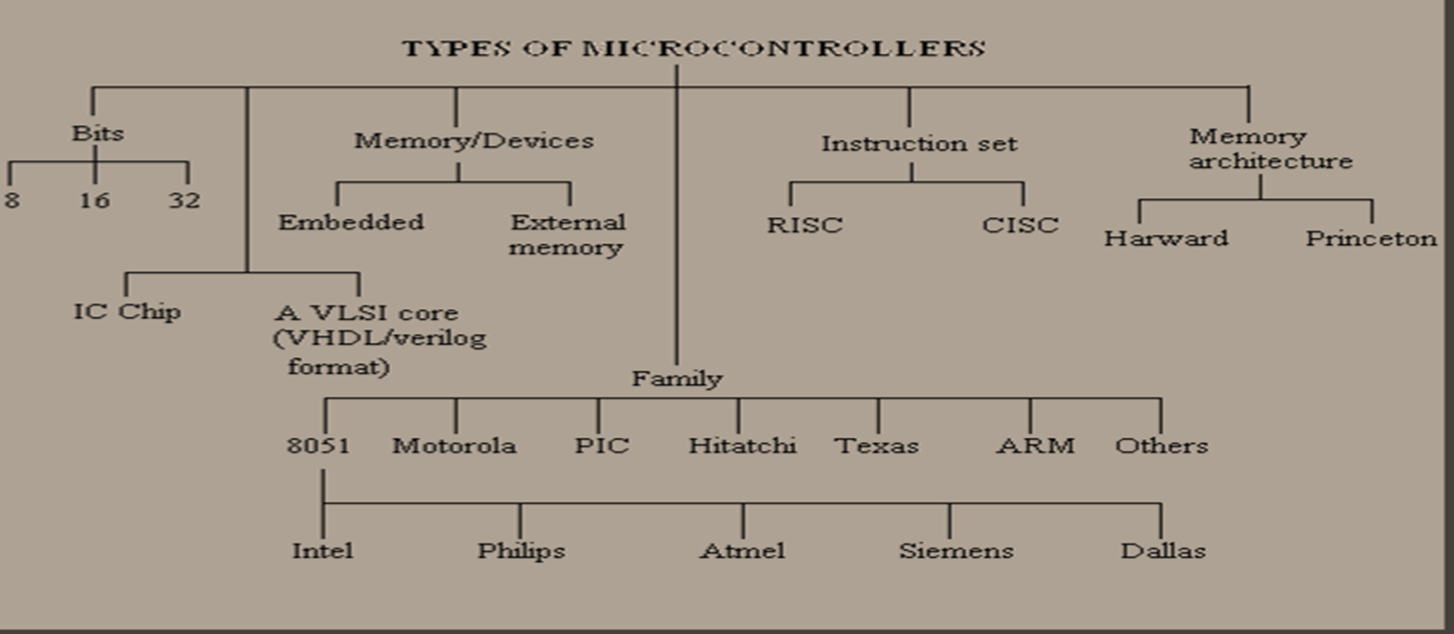
Best suited microcontroller for design of Embedded System?
There is always a trade off between efficiency and power dissipation. To know this, let us review the various types of microcontrollers and their specifications and the vendors.

Slide 24
Common Microcontrollers
Atmel
ARM
Intel
  8-bit
    8XC42
    MCS48
    MCS51
    8xC251
  16-bit
    MCS96
    MXS296
National Semiconductor
  COP8
Microchip
  12-bit instruction PIC
  14-bit instruction PIC
    PIC16F84
  16-bit instruction PIC
NEC
Motorola
  8-bit
    68HC05
    68HC08
    68HC11
  16-bit
    68HC12
    68HC16
  32-bit
    683xx
Texas Instruments
  TMS370
  MSP430
Zilog
  Z8
  Z86E02

Slide 25
Cont…
The ARM processor is a strong option for better performance. But when we consider the power consumption, in the case of ARM it is around 400mW and the ATmega1031, AVR microcontroller consumes low power around 16.5mW, but provides low performance.
But the Texas instruments MSP430 with wide range of operation modes consumes only 1.2mW with reasonably good performance. So it is always left to the designer to choose a suitable device according to the requirement.

Slide 26
MCS-51 “Family” of Microcontrollers
8051 introduced by Intel in late 1970s
Now produced by many companies in many variations
The most popular microcontroller – about 40% of market share
8-bit microcontroller

Slide 27
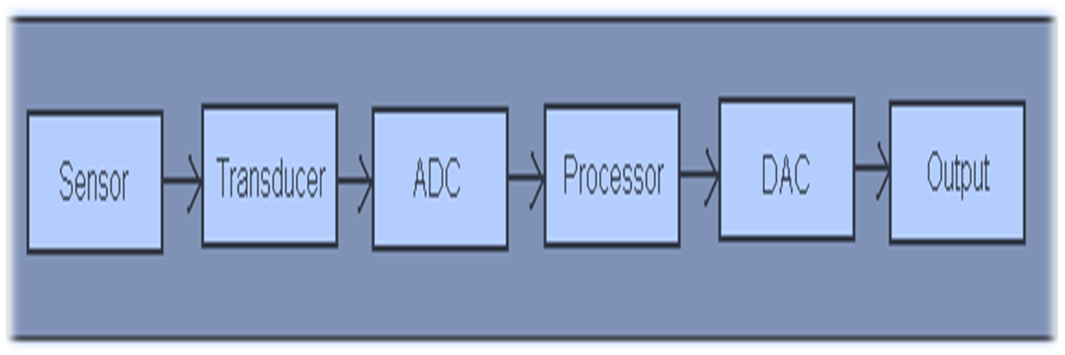
Design of an Embedded System a Case study
To understand the design of a simple embedded system let us first consider the idea of a data acquisition system. The data acquisition system is shown below:
Data Acquisition System

Slide 28
Cont…
For example let me consider a simple case of temperature measurement embedded system.
First we must select a temperature sensor like thermistor or AD590 or LM35 or LM335 or LM75 etc.
After this the analog data is converted into digital data and at the same time proper signal conditioning is done.
This digital input is fed to the microcontroller through its ports.
By developing a suitable program (Embedded C or Assembly) the data is processed and controlled.
For this purpose keil or Ride or IAR ARM Embedded workbench C compilers can be used.
Once the program is debugged, and found error free it can be dumped into the microcontroller flash memory using ISP (Philips - Flash magic or any ISP).
Now, your microcontroller chip acts as an embedded chip.

Slide 29
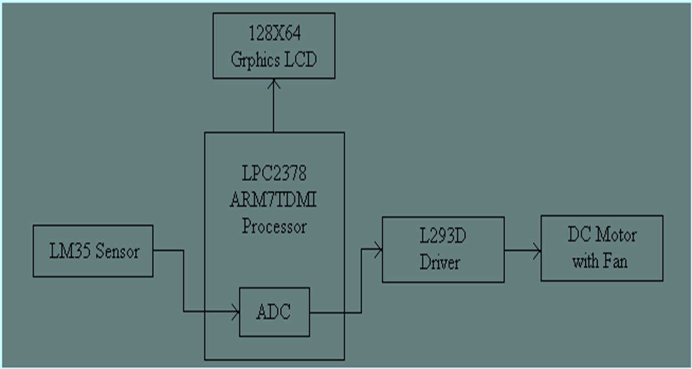
Block Diagram of Case Study
Embedded Systems

Slide 30
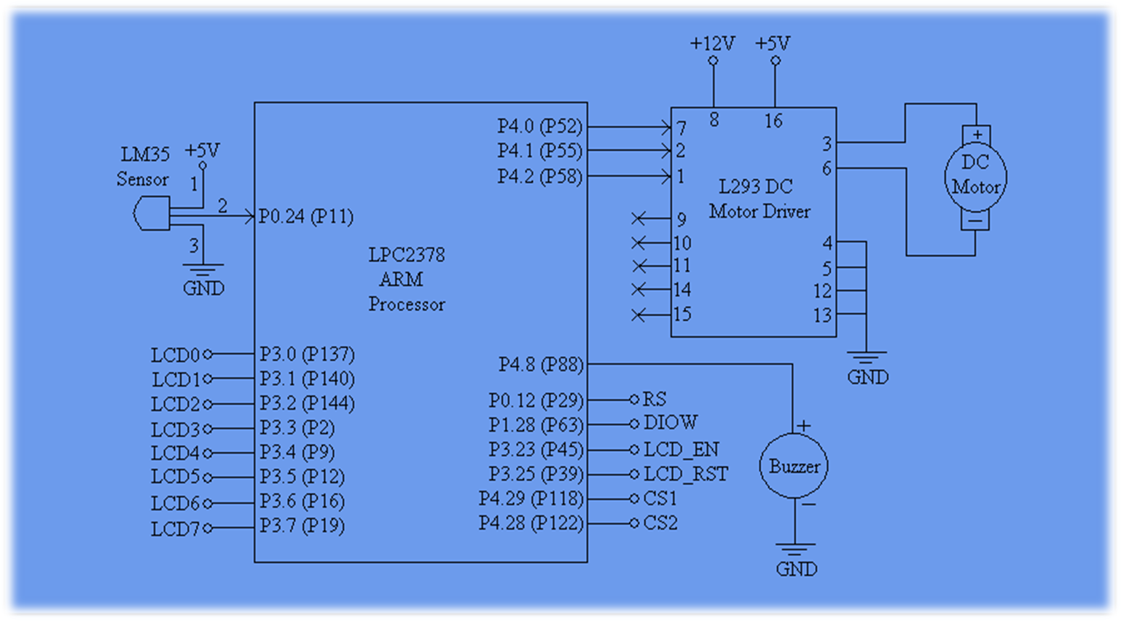
Schematic of Case Study
Embedded Systems

Slide 31
Embedded C softwares
Keil μvision evaluation version can be
downloaded from www.keil.com
Embedded C compiler Ride can be downloaded freely from www.raisonance. com
Embedded IAR ARM Workbench can be downloaded from www.iar.com

Slide 32
Books that helped to understand the Embedded Systems
1) Barr, Michael, “Programming Embedded Systems in C and C++ “, O-Reilly Publ.
2) Raj Kamal, “Embedded systems”, TMG
3) Valvano, “Introduction to Embedded Microcomputer Systems”, Thomson Publ.
4) Mazidi and Mazidi, “The 8051 Microcontroller and Embedded Systems”, Pearson education.
5) Peatman,J.B. “Design with Microcontrollers and Microcomputers”, McGraw Hill
Sewart. J.W. “The 8051 Microcontroller Hardware, Software and Interfacing”, Prentice Hall
Ayala Kenneth, “The 8051 Microcontroller Architecture, Programming and Applications”, Delmar Publ.
Ajay Deshmukh, “Microcontrollers”, TATA McGraw Hill
Rajkamal, “Microcontrollers Architecture, Programming”,Pearson Publ.
Myke Predko, “Programming the 8051 Microcontroller”, McGraw Hill
Michael J. Pont, “Embedded C”, Addison Wesely Publ.
Steve Heath, “Embedded System Design”, – Heinemann Publ.
Frank Vahid, “Embedded systems a unified hardware/software Introduction”, John Wiley and sons Publ.
Barnett Cox & O’cull, “Embedded C Programming & the Microchip PIC”, Thomson Delmar Learning.

Slide 33
Website References
http://www.eg3.com
http://www.ARM.MCU.com
http://www.mcjournal.com
http://www.iar.com
http://www.keil.com
http://www.semiconductors.philips.com/microcontrollers
http://www.embedded.com
http://www.powersoftsystems.com
www.macrovision.com/newsletters
www.planarembedded.com
www.8051.org
www.8051projects.net
www.programmersheaven.com
www.microcontrollershop.com

Slide 34
Concluding Remarks
There’s still lot more to learn, but with these basics under your grip it’s just a small matter of gaining experience
Good luck!

